Slide 1




BookByte

Slide 2

Overview
Introduction
mission
Home
About Us
Categories
Favorites
Contact
Our Team

Slide 3

Introduction
Welcome to Bookbyte, a platform designed for book lovers to enjoy reading a wide variety of books for free. Our website provides a seamless and enjoyable reading experience through a user-friendly interface. With five main sections:
Home: Get a quick overview of featured books and the latest additions to our library.
About: Learn more about our mission to make books accessible to everyone and the story behind Bookbyte.
Category: Explore a diverse range of book categories to find the perfect read for any mood or interest.
Favorite: Create a personalized list of favorite books to easily return to them anytime.
Contact: Get in touch with us for any inquiries, feedback, or suggestions.
With Bookbyte, we aim to foster a reading community where everyone can discover, share, and enjoy books at no cost.

Slide 4

Our mission
At Bookbyte, our mission is to make knowledge and stories accessible to everyone by providing a free and diverse collection of books. We aim to create an inclusive and engaging platform that fosters a love for reading, supports lifelong learning, and encourages the discovery of new ideas. Through our user-friendly website, we strive to connect readers with books they’ll love, making reading a more enjoyable and accessible experience for all.

Slide 5
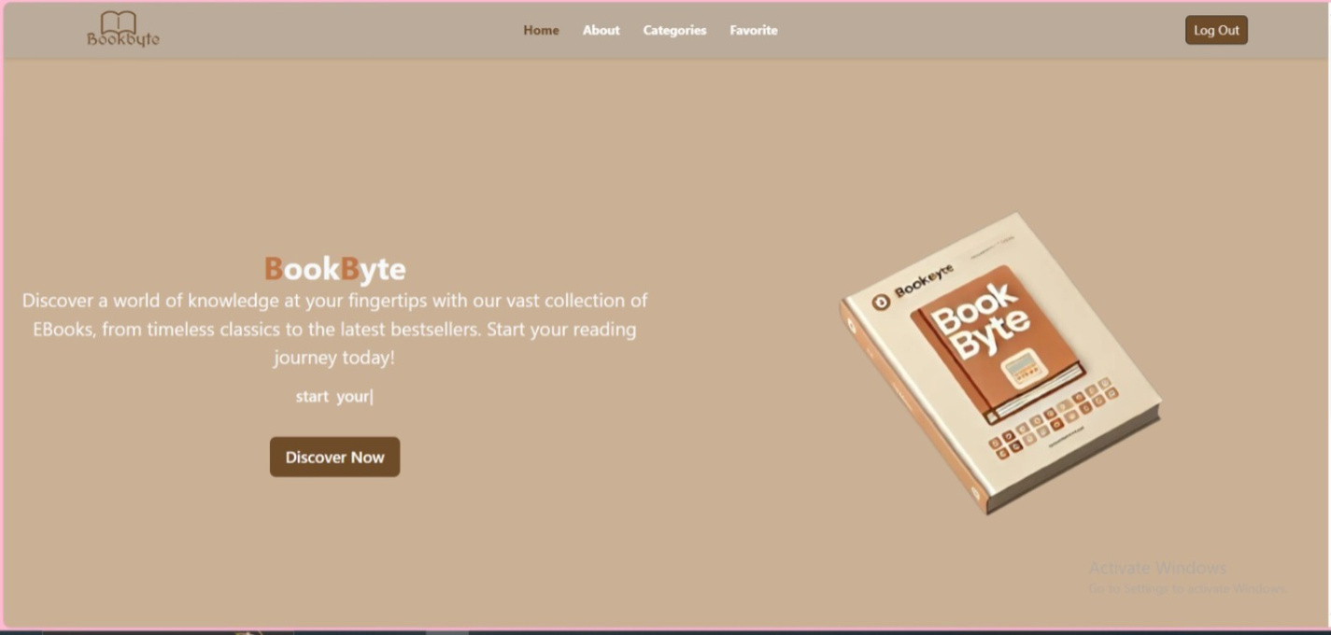
Home page
The home page is the first thing users see after logging in. It offers a clean and attractive design where users can instantly browse through featured books or start searching for their favorite titles. The design ensures quick access to book collections, making it easy for users to dive straight into reading.

Slide 6
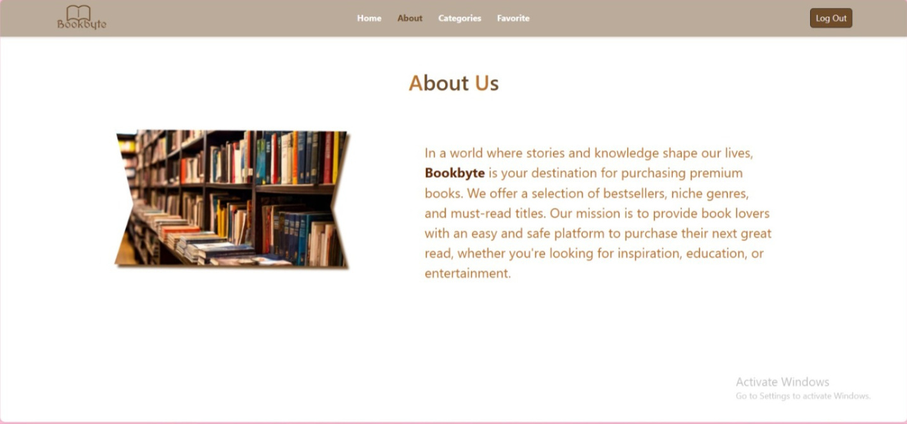
About page
The page contains an 'About Us' section with a brief description of Bookbyte, highlighting its role in offering a selection of books, including bestsellers and niche genres, through a secure platform.

Slide 7
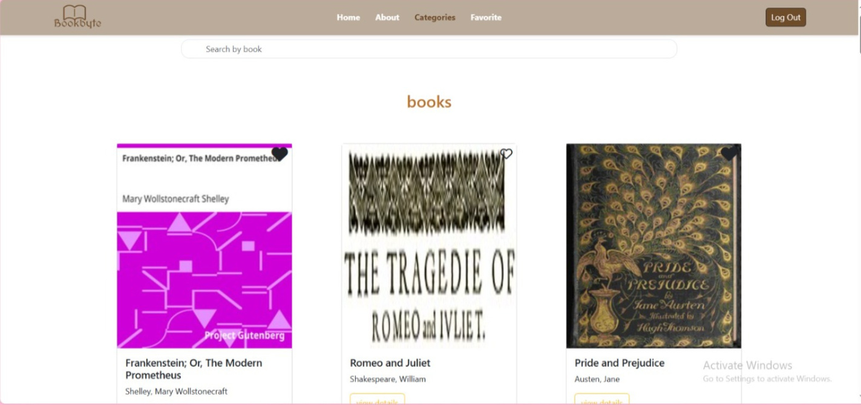
Categories page
This is the categories section, which makes it easier for users to discover new books based on their preferences. Whether they're interested in fantasy, non-fiction, science fiction, or biography, the category system ensures that users can quickly find books that match their interests.

Slide 8
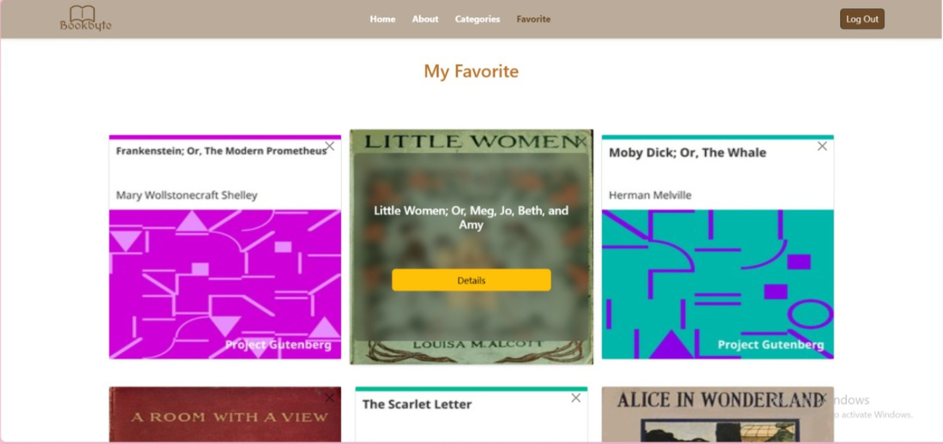
Favourite page
The Favorites section displays a grid of classic book titles, such as Frankenstein and Little Women. Each book entry includes the title and author, and some have a "Details" button for more information.

Slide 9
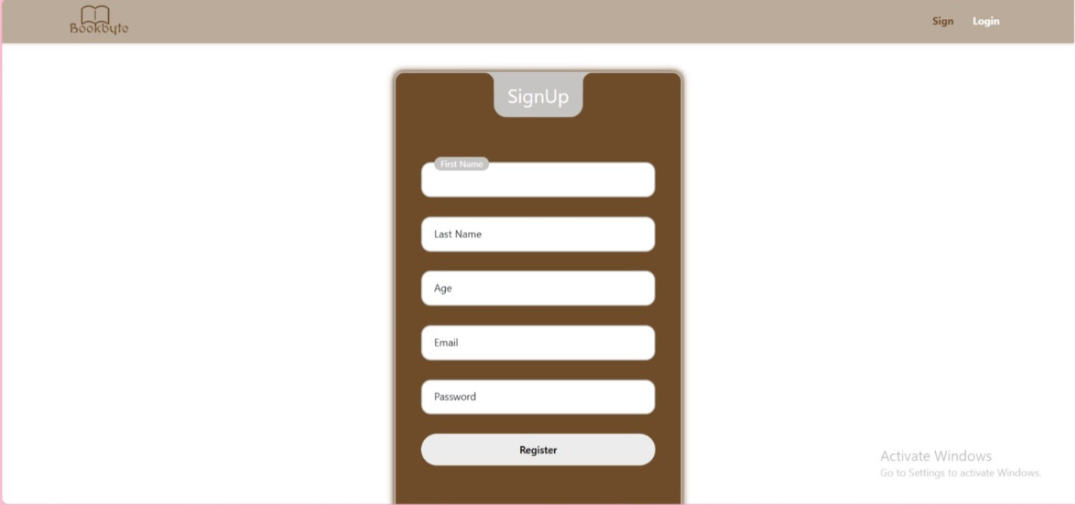
Contact page
Finally, the Contact Us page allows users to create accounts to manage their personal library, including saved books and reading history. This feature adds a personal touch to the user experience, making sure they can access their preferences across multiple devices.

Slide 10
Our Team
Merna aboelhaythem
Nooran Al-Deeba
Cherouk Chehata
Hani Al-Saei
Mahmoud Ammar
Gamal Bassiouny

Slide 11

THANK YOU!

